Slide 1
Bubble Sorting In C++

Slide 2
Sorting An Array
Sorting: Arranging values of an array in Ascending or Descending order.
E.g., 65, 34, 12, 7, 5, 2, 1 {Descending order}
3, 13, 23, 37, 49, 87 {Ascending order}
Bubble Sort
• Repeatedly stepping through the array to be sorted, comparing each pair of adjacent items and swapping
them if they are in the wrong order. The pass through the array is repeated until no swaps are needed (which indicates that the list is sorted)

Slide 3
Sorting
Sorting takes an unordered collection and makes it an ordered one.
1 2 3 4 5 6
77
42
35
12
101
5
1 2 3 4 5 6
5
12
35
42
77
101

Slide 4
"Bubbling Up" the Largest Element
Traverse a collection of elements
Move from the front to the end
“Bubble” the largest value to the end using pair-wise comparisons and swapping
1 2 3 4 5 6
77
42
35
12
101
5

Slide 5
"Bubbling Up" the Largest Element
Traverse a collection of elements
Move from the front to the end
“Bubble” the largest value to the end using pair-wise comparisons and swapping
Swap
1 2 3 4 5 6
42
77
77
42
35
12
101
5

Slide 6
"Bubbling Up" the Largest Element
Traverse a collection of elements
Move from the front to the end
“Bubble” the largest value to the end using pair-wise comparisons and swapping
1 2 3 4 5 6
Swap
35
77
42
77
35
12
101
5

Slide 7
"Bubbling Up" the Largest Element
Traverse a collection of elements
Move from the front to the end
“Bubble” the largest value to the end using pair-wise comparisons and swapping
1 2 3 4 5 6
Swap
12
77
42
35
77
12
101
5

Slide 8
"Bubbling Up" the Largest Element
Traverse a collection of elements
Move from the front to the end
“Bubble” the largest value to the end using pair-wise comparisons and swapping
1 2 3 4 5 6
42
35
12
77
101
5
No need to swap

Slide 9
"Bubbling Up" the Largest Element
Traverse a collection of elements
Move from the front to the end
“Bubble” the largest value to the end using pair-wise comparisons and swapping
1 2 3 4 5 6
Swap
5
101
42
35
12
77
101
5

Slide 10
"Bubbling Up" the Largest Element
Traverse a collection of elements
Move from the front to the end
“Bubble” the largest value to the end using pair-wise comparisons and swapping
1 2 3 4 5 6
101
42
35
12
77
5
Largest value correctly placed

Slide 11
The “Bubble Up” Algorithm
index <- 1
last_compare_at <- n – 1
loop
exitif(index > last_compare_at)
if(A[index] > A[index + 1]) then
Swap(A[index], A[index + 1])
endif
index <- index + 1
endloop

Slide 12
No, Swap isn’t built in.
Procedure Swap(a, b isoftype in/out Num)
t isoftype Num
t <- a
a <- b
b <- t
endprocedure // Swap

Slide 13
Sorting An Array(Ascending) (Using bubble sort)

Slide 14
Sorting An Array(Ascending)
int a[10]={33,10,1,87,6,44,23,3,11,82};
int i,j,temp;
int N=10;
for (i=0; i<N; i++)
{
for (int j=0; j<N-i-1; j++)
if (a[j] > a[j+1])
{ temp = a[j];
a[j] = a[j+1];
a[j+1] = temp;
}
}

Slide 15
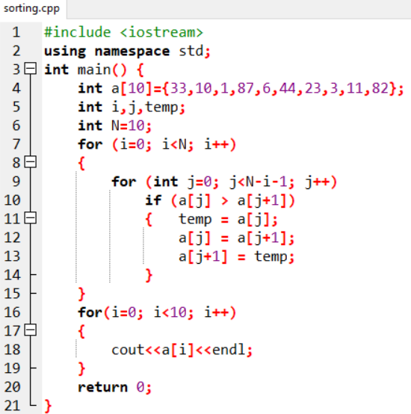
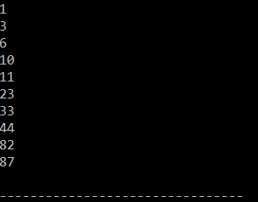
Sorting An Array(Ascending)

Slide 16
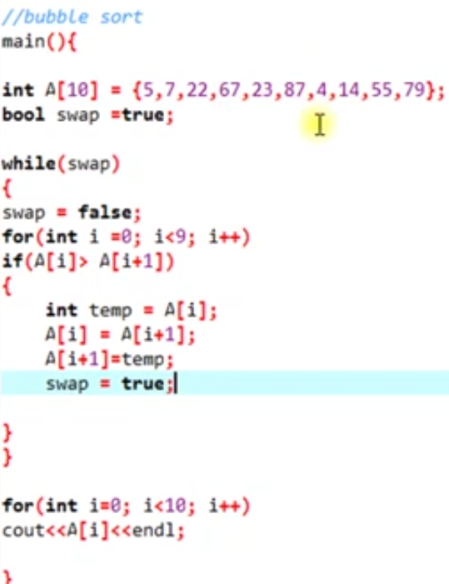
Sorting An Array(Ascending)
Bubble Sorting in C++ Using Flag

Slide 17
Sorting An Array(Descending)
int a[10]={33,10,1,87,6,44,23,3,11,82};
int i,j,temp;
int N=10;
for (i=0; i<N; i++)
{
for (int j=0; j<N-i-1; j++)
if (a[j] < a[j+1])
{ temp = a[j];
a[j] = a[j+1];
a[j+1] = temp;
}
}

Slide 18
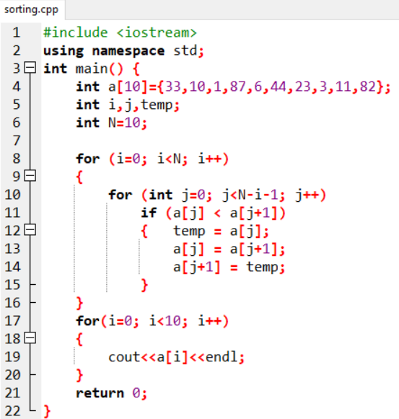
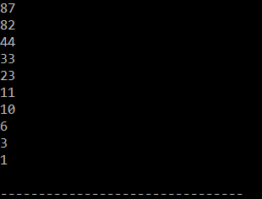
Sorting An Array(Descending)

